Slide 1
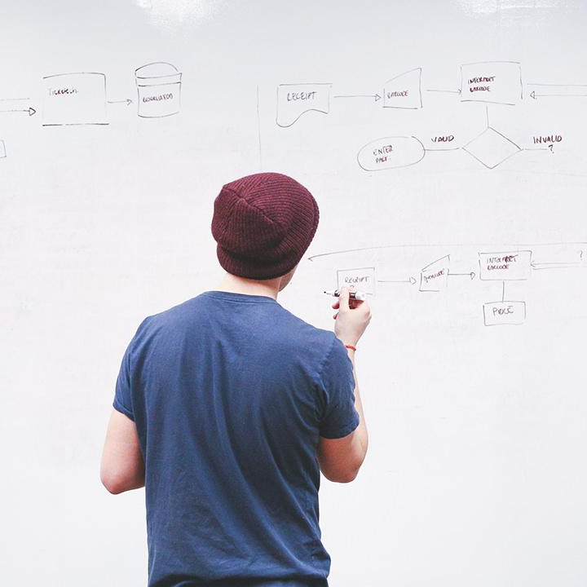
HELLO!
Here 1Crore Projects
I am here because I love to give presentations.
You can find me at @1CROREPROJECTS

Slide 2
A Blockchain based Autonomous Decentralized Online Social Network

Slide 3

AIM OF PROJECT
The main aim of the project to identify a block chain by a different section and request friend through Tweets based on Block chain.

Slide 4
ABSTRACT
An OSN service is developed based on blockchain technology in order to make it operate decentralized.
Large volume of data normally required low-security requirements can be stored in Interplanetary Filesystem (IPFS) to make data decentralized.
A decentralized autonomous organization is developed for user autonomy, users can self-manage the OSN in a democratic way.

Slide 5
INTRODUCTION
An autonomous decentralized online social network architecture based on blockchain technology. Blockchain is able to provide a safe and trusted peer-to-peer mechanism where participants have unique identities and private keys.
The private key has the highest control right of the corresponding account and is stored in user’s own device. Moreover, all transactions in blockchain need to be signed by the private key, so cheating can be avoided.

Slide 6
EXISTING SYSTEM
Online social networks (OSN) are becoming more important in people's daily life, however, all popular OSNs are centralized, and this raises a series of security, privacy and management issues.
A decentralized architecture based on blockchain technology provides the ability to solve above issues

Slide 7
DISADVANTAGES
Without tweet id the user does not post any things
User can gives there Tweets post or rating without login page

Slide 8
PROPOSED SYSTEM
A blockchain also has encryption and consensus mechanisms in order to make the blockchain is synchronous in every node. When a user generates a transaction in the user side, the data of the transaction is encrypted by the private
Therefore, this character prevents blockchain from been tampered, makes sure the data will no longer be modified once it is recorded on the blockchain

Slide 9
ADVANTAGES
Data was secure
By the different fields create a unique block is used to search a customer need.

Slide 10
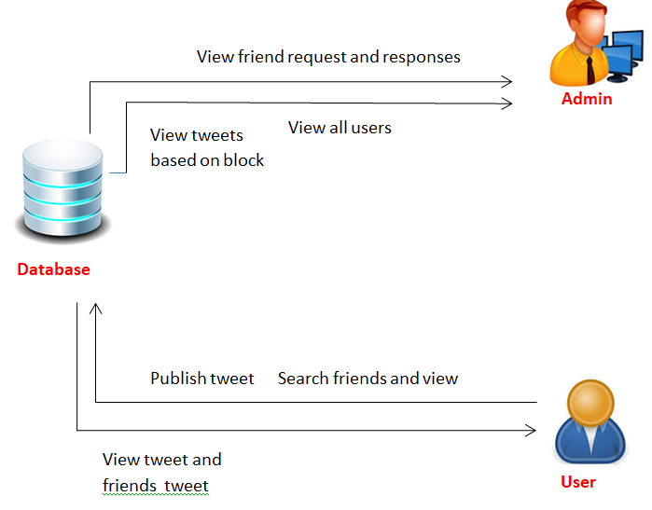
SYSTEM ARCHITECTURE

Slide 11
MODULES
In this project has two modules:
Admin
User

Slide 12
ADMIN
Login the account with the correct username and password and authorize
view all users view friend request and response
view all users details based on (Scientist, Engineer, Doctor) blockchain
view tweets recommendations
view all tweets rank in chart
logout

Slide 13
USER
Register(Scientist, Engineer, Doctor)
search friend
view friend request
view all my friend
publish tweet if user scientist. the block will add in Scientist block

Slide 14
USER
If user Engineer. the block will add in Engineer block
If user Doctor. the block will add in Doctor block
View all my tweets
View all my friends tweets
View all recommended tweets
Logout

Slide 15
HARDWARE REQUIREMENTS
System | Intel i3 and above
Hard Disk | 40GB
RAM | Minimum 4GB
Processor | 64-bit, four-core, 2.5 GHz minimum per core

Slide 16
SOFTWARE REQUIREMENTS
Front End Language | HTML, CSS, JAVA, JSP SERVELTS
Backend | My SQL
Operating System | Windows 10 or 11
IDE | JAVADEVELIPEMENKIT

Slide 17
FUTURE WORK
For future work, a user-friendly interface will be developed in order to replace the CLI clients since they are not very suitable for normal users.

Slide 18
CONCLUSION
Users keep their security information under their control, in order to avoid security information leakage from centralized servers. Additionally, since the social network service is decentralized, users do not need to worry about service crash down by centralized entity.

Slide 19
REFERENCE
[1] D. Chaffey, "Global social media research summary 2020 | Smart Insights", Smart Insights, 2020. [Online]. Available: https://www.smartinsights.com/social-media-marketing/social-mediastrategy/new-global-social-media-research/. [Accessed: 03- May- 2020].
[2] L. Constantin, "Credential stuffing explained: How to prevent, detect and mitigate", CSO Online, 2019. [Online]. Available: https://www.csoonline.com/article/3448558/credential-stuffingexplained-how-to-prevent-detect-and-defend-against-it.html. [Accessed: 30- Apr- 2020].
[3] S. Nakamoto, "Bitcoin: A Peer-to-Peer Electronic Cash System", Bitcoin.org, 2008. [Online]. Available: https://bitcoin.org/bitcoin.pdf. [Accessed: 16- Feb- 2020].

Slide 20
THANKS!
Any questions?
You can find me at
Reach us – 1croreprojects@gmail.com
Contact / Whatsapp: 7708 150 152 / 9751 800 789 / 790 432 0834

